Slide 1
Doppler: back to basics
Dr. Rose Lee

Slide 2
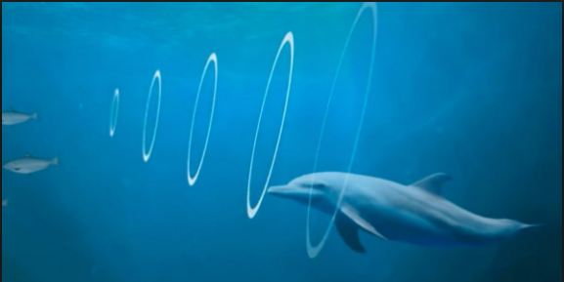

Slide 3
Ultrasound Image Quality
Grey Scale 2D optimization
series of shades from white to black
Colour/Power/Spectral doppler optimization

Slide 4
Optimizing 2D Images (after presets)
Depth
Sector width
Frequency (after picking correct transducer probe)
Focus
Gain
Time Gain Compensation or TGC
Zoom
Dynamic Range (contrast)
Persistence, Frame Rate

Slide 5
Depth
Start with higher depth
Decrease depth to have ROI at ¾ depth of screen
Leave small area around the ROI to look for useful artefacts (enhancement, shadowing etc.)
Small depth of field - superficial structures
Large depth of field - deeper structures

Slide 6
Depth
Affects the frame rate of the image
Affects pulse repetition frequency
Decreasing depth increases the PRF and frame rate

Slide 7
Depth
Too little
Too much

Slide 8
Depth Optimized

Slide 9
Sector Width
Routine setting
More appropriate

Slide 10
Sector Width improves temporal resolution

Slide 11
Frequency
Adjusting the frequency allows you to increase resolution at the expense of penetration
Higher Frequency: higher resolution, less depth
Lower Frequency: lower resolution, better for deeper structures (better penetration)
Best to start in the middle range and adjust
Must chose the correct probe
Remember 10C3 for Obstetrics and pediatric patients
18L vs 12L for small parts, breast, thyroid etc.

Slide 12
10C3 vs 6C3

Slide 13
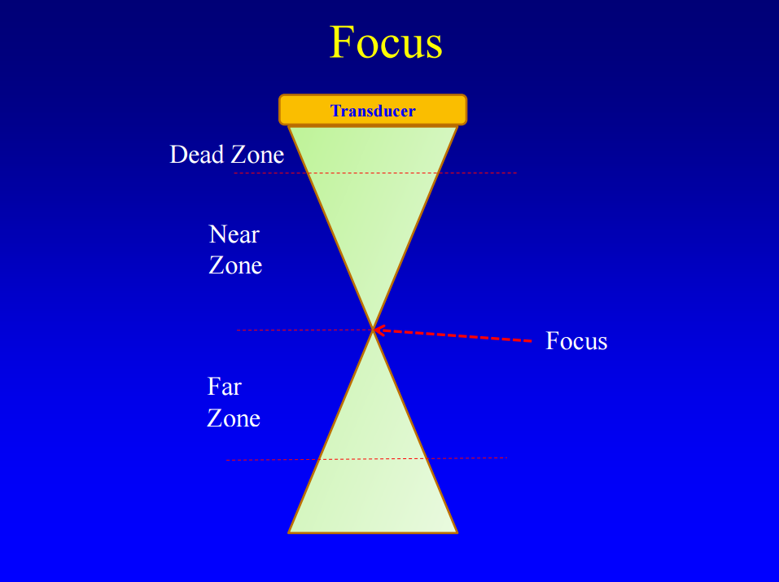

Slide 14
Focus
Describes the distance from the transducer at which the beam is optimized for spatial resolution
Focus positioned at or just below the object you are scanning (larger organ: middle)
Increasing the number of focal zones:
frame rate will decrease
image will refresh slowly

Slide 15
Focus

Slide 16
Gain (overall image gain)
Measure of the strength of the ultrasound signal
Overall gain amplifies all signals by a constant factor regardless of the depth
Like the brightness function of a TV set
A simple twist can make a too dark image brighter allowing you to see subtle differences in texture
Cost of increasing the 2D gain is a decrease in spatial resolution due to increased noise

Slide 17
Gain (overall image gain)
Gain set too high: excessive brightness of the white and gray elements obscure the fine details of the image
Gain set too low: image will appear too dark to define certain structures
Adjust to the minimum required to obtain an adequate image i.e. there should be a complete range from low (dark gray) to high (white) amplitude signals

Slide 18
Gain
Too low
Too high

Slide 19
Gain Optimized

Slide 20
Zoom and Magnification
Write zoom: an area of the potential image is selected and the ultrasound field and processing is restricted to that area
better image quality
may be consequent benefits of frame rate and spatial resolution in the magnified image
Read zoom: an area of the obtained image is selected and magnified (only magnification)
displayed image rapidly becomes pixelated

Slide 21
Time Gain Compensation (TGC)
Allows amplification of the weaker signals returning from the far field more than the signals returning from shallower depths
Used to compensate for increasing attenuation by increasing amplification of the return signal with depth

Slide 22
Time Gain Compensation (TGC)
Usually set so that controls for near field are lower and far field higher
Some ultrasound units automatically compensate for the attenuation of the far field and therefore require a lower setting in both the far field and near field—set these units in a “bell-shape”
Quick scan can be useful as a starting point

Slide 23
TGC

Slide 24
Time Gain Compensation (TGC)

Slide 25
Dynamic Range (Contrast)
Adjusts the overall number of shades of gray
How white is white
How black is black

Slide 26
Dynamic Range
Increasing the DR :
higher number of gray scale levels (increased spatial resolution by increased contrast levels)
increased image detail and smoother images
Decreasing the DR:
increases the contrast of the image, with more black and white areas than shades of gray

Slide 27
Dynamic Range
Too high
Too low

Slide 28
Dynamic Range

Slide 29
Frame Rate
Number of images produced and updated per second
Determines how smooth the image appears (depends upon image depth, width and scan line density)
Decreasing the depth and width of the sector allows for a higher frame rate and improved image resolution

Slide 30
Persistence
Updating and averaging of consecutive frames on the screen to reduce noise and speckling.
Increased persistence will smooth out the images but sacrifices crispness of moving structures
Decreased persistence will give a grainier image
Higher levels of persistence are more desirable for slow moving structures and lower levels for rapidly moving structures

Slide 31
Colour Doppler
Depicts presence and direction of blood flow
It is a display of mean frequency
Pro:
Overall view of flow in the region
Rapid assessment of flow direction and velocity
Cons:
Limited flow information (esp deep tissue)
Poorer temporal resolution at increased depth

Slide 32
Colour Doppler Optimization
Wall filter setting
Box Size
Sector width/frequency/focus/zoom
Colour gain
Colour Scale or Pulse Repetition Frequency (PRF)

Slide 33
Wall Filter Setting
Colour, power and spectral settings all have different wall filter levels
Computer selectively ignores velocities below a set limit
Filter settings are usually preset by the manufacturer: high, medium, or low filter setting
Use the lowest possible setting always

Slide 34
Box Size
Box can be adjusted in
Width
Height
Depth into patient

Slide 35
Box Width
By reducing the width, each frame can be completed in much less time: increasing the frame rate

Slide 36
Box Height
If the depth of the colour box in the patient is reduced, return of signal faster: faster frame rate

Slide 37
Box Size
Change depth and width of box so it covers only the area of immediate interest
Do not make color box too wide: decreases the frame rate
Do not make color box too long: deeper the sampling, lower the scale due to increased transit time and sampling area

Slide 38
Box Size

Slide 39
Colour Gain
Amplifies or decreases the Doppler shift signal
Too much gain results in excessive noise and detracts from image quality
Too little gain diminishes the sensitivity of the system to detect low flow
Increase the gain until a little bit of speckle artifact is seen, then slightly decrease the gain to only just eliminate the speckle artifact

Slide 40
Colour Gain

Slide 41
Colour Scale or Pulse Repetition Frequency (PRF)
Number of pulses launched per second by the transducer
Increases or decreases the maximum velocity that can be displayed without aliasing
The PRF can be altered by the operator to prevent aliasing or to detect low blood flow
As a general rule the PRF should be ideally set at approximately half of the expected velocity of the blood flow in the ROI
The PRF is determined by various controls such as colour box size and velocity range

Slide 42
PRF
Scale is limited by the maximum depth of field of view
Maximum colour PRF is achieved when spectral Doppler is switched off and the colour box width is decreased as much as possible.

Slide 44
Colour Scale

Slide 47
Colour Doppler Artifacts
Poor spatial resolution: especially deeper structures
Aliasing: abnormally high velocities exceed the rate at which the system can record the velocity correctly
Methods to eliminate:
Increase the PRF or velocity scale
Shift the baseline
Increase the angle of approach
Decrease transducer frequency

Slide 48
Colour Doppler Artifacts
High colour gain: produces colour noise and obscures the true Doppler signal
Eliminate by setting gain just below the introduction of random colour or speckle
Flash artifact: sudden marked movement of the transducer or the tissue within the field of view
Eliminate by holding transducer still and asking patient to be still ie breath hold

Slide 49
Colour Doppler Tips
To Increase sensitivity: esp for low velocity
Decrease velocity scale or PRF
Move focus position to the region of interest
Decrease colour box
Increase colour gain
Decrease wall filter
To Decrease flash artifact
Decrease colour gain
Decrease the depth of field of view
Decrease sector size
Use Zoom function

Slide 50
Power Doppler Imaging
Increased sensitivity to low velocity flow
No direction of flow information
No velocity information
More flash artefacts
Use on all masses if cannot obtain flow on colour doppler
Decrease 2D gain to increase sensitivity
Sometimes flow can be eliminated with too much transducer probe pressure

Slide 51
Power Doppler
Use in situations to figure out solid vs cystic
Soft tissue lumps
Breast lumps
Lymph nodes
Low flow/diminished flow
Confirmation/exclusion of testicular torsion
Do not forget to obtain spectral tracing to confirm it is not artefact

Slide 52
Spectral Doppler
If detect flow on either colour/power doppler, must perform spectral trace to confirm vascularity is present: confirms mass is SOLID or vascularity is present
Number one error: incorrect colour and velocity scales
Everyone must learn how to adjust scale on the US machines

Slide 53
Spectral Doppler Optimization
Angle
Spectral Gain
Gate size and position
Velocity scale
Baseline
Avoid transducer motion

Slide 54
Angle
For MCA doppler:
angle of insonation of zero degrees ensures most accurate measurement of the PSV

Slide 55
Spectral Gain
Gain should be adjusted to outline the contour of the depicted waveform
Too low a setting falsely suggests absent flow
Independent of colour and power gains

Slide 56
Spectral Gain

Slide 57
Gate Size and Position
Sample size from which the signal is obtained with pulsed Doppler
Should be as small as possible to exclude erroneous signal arising from adjacent vessels or marginal flow
About 2/3 of vessel width in center

Slide 58
Gate Size and Position

Slide 61
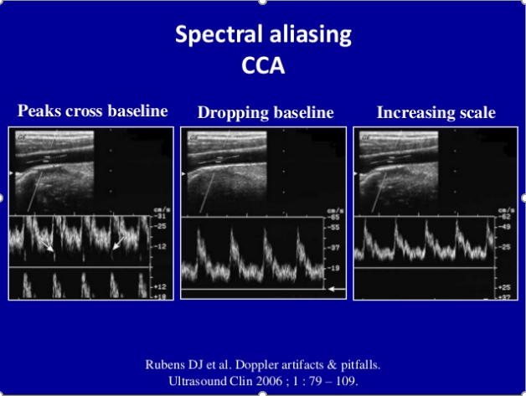

Slide 63
Clinical Applications
Soft tissue masses or any mass anywhere
Lymph nodes/neck masses
Breast
Ovarian
Scrotal
Obstetrical

Slide 64
Palpable Masses
Confirm presence of a mass
Location of mass
Characterize mass
Cyst vs solid
Vascularity
Dynamic information – compression
However, majority of soft tissue masses have nonspecific appearance: DDx driven by location

Slide 65
Scanning Protocol
Use a high frequency linear transducer first
May need to change to lower frequency probe if patient is large or mass extends into deep soft tissues or curvilinear
If the mass is small, trap mass between two fingers to hold down while scanning
Start scanning the nearby, NORMAL, uninvolved area to appreciate normal anatomy (can scan contralateral side too)

Slide 66
Scanning Protocol
First image mass to show relationship with respect to soft tissue layer
Large FOV
Scan along the border of the mass
Then image to show mass close up in detail to assess edges, internal characteristics, and vascularity (may need standoff pad or lots of gel)
Take at least 3-5 images in sagittal and axial through the mass or more if large

Slide 67
Location Location Location
Body location:
Draw an image
Describe with respect to external landmarks
Soft tissue layer:
Dermal: thin hyperechoic layer
Subcutaneous: hypoechoic fat interspersed with hyperechoic linear (connective tissue septa)
Fascial: thin hyperechoic layer
Muscle: hypoechoic cylindrical structures, with hyperechoic connective tissue, surrounding them
Bone: strong hyperechoic shadow

Slide 68
Normal Soft Tissues

Slide 69
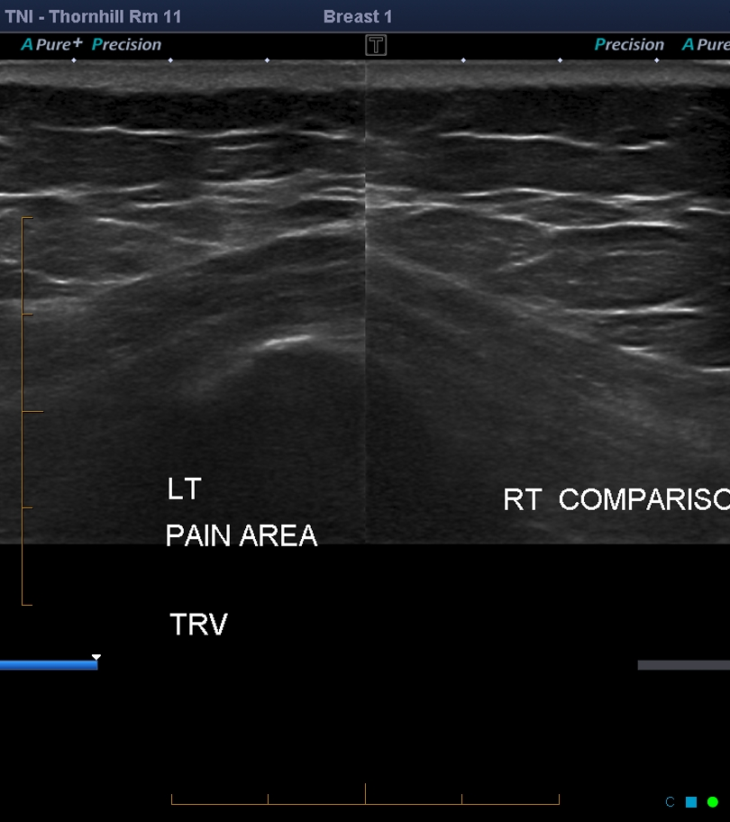

Slide 70
Characterize Mass
After determination of location
Assess
Shape and margins (image the edges)
Echogenicity
Internal characteristics
Through transmission
Vascularity
Dynamic: mobility and compression

Slide 71
Vascularity
Important to differentiate solid vs cystic
If present, confirms mass is solid
If absent, mass can be solid or cystic
Must show spectral doppler waveform to prove vascularity

Slide 72
Midclavicular lump

Slide 73
One Month Earlier

Slide 74
Incorrectly Dx: Complex Cyst
What went wrong
Image to contrasty DR 72
Wall filter 194 Hz vs WMF low 1
Velocity scale 6cm/s vs 10 cm/s
Optimize image
Scale could be reduced
Gate size and position

Slide 75
RLQ Mass Probable Lymphoma

Slide 76
How to Improve?
Colour box smaller only ROI: this could even be smaller with just minimal surround tissue
Spectral trace required to confirm

Slide 77
Retroaerolar Mass

Slide 78
What Should Be Next?
Spectral trace in center of lesion to prove solid
Not done is this case
Perilesional inflammation vs solid

Slide 79
Anterior Abdominal Wall Mass Diagnosis? Cystic or Solid?

Slide 80
Ways to Improve
2D image
Look for nipple extending toward skin surface
Decrease depth
Colour doppler
Colour box smaller: too wide for ROI
Check wall filter
Colour gain
Velocity scale

Slide 81
Do Not Forget
Next is to try power doppler as it is more sensitive for flow detection
That is why it is the gold standard for checking blood flow overlying embryo to confirm fetal demise

Slide 82
Bladder Wall Mass: 2 representative images, is there enough information provided?

Slide 83
On the images provided, colour box too large for the area of concern
No spectral tracing provided to prove this was a solid mass
Often seen flash artefact in a mass so need spectral tracing

Slide 84
Nerve Sheath Tumor: images for all masses

Slide 85
Perianal Mass: Solid vs Cystic

Slide 86
Where is the Vascularity?

Slide 87
Peripheral Only: Acute Inflammation

Slide 88
Left Posterior Neck Mass

Slide 89
Is There Really No Flow?
Ways to improve
Less depth in overall image: lesion superficial
Colour box smaller
Gate size and position
Velocity lower for spectral tracing

Slide 90
Rt Inguinal Mass Pregnant Patient ?hernia

Slide 91
Next Step?
Looks like a lot of vessels
Spectral trace to assess flow: arterial vs venous
Round Ligament varicosities

Slide 92
Lymph Node Assessment

Slide 93
LN Doppler Criteria
Benign
Malignant
Flow absent/minimal
Central vascular location
Single vascular pedicle
Regular vascular pattern
Low impedance values
Flow present
Peripheral vascular location
Multiple vascular pedicles
Chaotic vascular pattern
High impedance values

Slide 94
Vascular Location
Benign: central
Malignant: mixed central & peripheral

Slide 95
Vascular Pedicle
Benign: single
Malignant: multiple

Slide 96
Impedance
Benign: low
Malignant: high

Slide 97
Breast Masses
After all 2D criteria
Assess for vascularity
Colour doppler
Power doppler
Confirm with spectral doppler

Slide 98
Breast Lesion: increased in size on F/U

Slide 99
What is the Diagnosis?
What should have been done next?
Spectral tracing to prove there is vascularity vs flash artefact
Common for flash artefact in mobile echoes within lesion
Could be complex cyst, patient recalled for spectral doppler

Slide 100
Ovarian Lesions
Unless an ovarian mass is a simple ovarian cyst, use colour doppler to assess for vascularity (power doppler if required)
Simple cyst criteria:
anechoic
intraovarian or exophytic
an imperceptible wall
posterior acoustic enhancement (which may not be as obvious with harmonic or compound imaging)
visible far wall

Slide 101
IOTA ultrasound rules for ovarian masses
Benign: at least 1 of these & no malignant
Malignant: at least 1 of these & no benign
unilocular cyst
smooth multilocular tumour
solid component <7 mm in diameter
Acoustic shadows
No detectable Doppler signal
irregular solid tumour
irregular multilocular mass >10 cm in diameter
≥4 papillary structures
ascites
high Doppler signal

Slide 102
Simple ovarian cysts with stroma in between

Slide 103
Corpus Luteum
Ring of fire
Power doppler used

Slide 104
Hemorrhagic Cyst
Use of power doppler to show no definite flow
Colour box still a little too big

Slide 105
Endometrioma
Low level echoes
Look for these tiny foci adhering to walls

Slide 106
Common Colour Box Problem
The colour box is too large taking up the whole field of view
Small and superficial box
use power doppler

Slide 107
Ovarian Complex Masses

Slide 108
Colour/Power & Spectral Tracings on all areas
Power used to detect flow
Colour box on mural component

Slide 109
48 yo Bilateral Hypoechoic Ovarian Masses
MRI dx fibromas
Solid mass even without colour

Slide 110
Reminders
Even when no definite colour flow, mass can still be solid
Must optimize assessment: in this case colour box too big, PRF probably too high and wall filter could have been decrease, should have used POWER doppler
Must optimize for low velocity flow

Slide 111
Scrotal Doppler Assessment
Colour/power doppler of each testicle in all patients regardless of age (use power if required)
Spectral tracing in center of testicle
Arterial tracing
Venous tracing for all patients who are symptomatic
Use appropriate velocity scale 10cm/s
Epidydimal colour flow must be compared with ipsilateral testicle on the same view for comparison to assess for epididymitis

Slide 112
Scrotal Doppler

Slide 113
Common Doppler Issues
Sampling too peripheral
Velocity scale is too high

Slide 114
Epididymitis?

Slide 115
Compare with Testicle
As long as adjacent testicle has similar vascularity to contralateral testicle, good marker for comparison with epididymis

Slide 116
Obstetrical Applications
Umbilical artery
Middle cerebral artery

Slide 117
Fetal Doppler Check list
Check wall filter
Check scale
Check tracing
Check waveform
Check diastolic flow (always positive flow)
Check numbers

Slide 118
Umbilical Artery
Surveillance of fetal well-being
Abnormal umbilical artery doppler marker of uteroplacental insufficiency and consequence of IUGR or suspected pre-eclampsia
Technique:
Sample free mid-loop of the umbilical cord with magnification of the cord for better visualization
Use colour doppler before spectral trace to see sample vessel area more clearly
3 different samples (not 1 tracing measured in 3 places)

Slide 119
Watch Technique
Magnify the area with colour doppler so know the gate is in the correct position
Cannot tell on this image without colour

Slide 120
Umbilical Artery Doppler
Umbilical arterial waveform: "saw tooth" pattern with flow always in the forward direction
Abnormal if no end-diastolic flow (even if at the end or transient) or reversal of flow
Calculate both S/D ratio and PI – using at least 3 good waveforms
Pick best wave form PI value or if intermittent abnormally high, give range of PIs

Slide 121
Umbilical Artery Normal

Slide 122
Umbilical Artery Waveform
Normal
Abnormal

Slide 123
Reference ranges for serial measurements of umbilical artery Doppler indices in the second half of pregnancy American Journal of Obstetrics and Gynecology (2005)

Slide 124
Reference ranges for serial measurements of umbilical artery Doppler indices in the second half of pregnancy American Journal of Obstetrics and Gynecology (2005)

Slide 125
Abnormal High UA PI in Midloop
Perform spectral doppler of EACH intraabdominal umbilical artery around fetal bladder, more specific and easier for F/U
Take 3 or more samples of each artery
If umbilical artery intraabdominal portion PI is high or if waveform is abnormal do not let patient go home

Slide 126
Reference ranges for serial measurements of blood velocity and pulsatility index at the intra-abdominal portion, and fetal and placental ends of the umbilical artery Ultrasound Obstet Gynecol 2005; 26: 162–169

Slide 127
UA PI high in Mid Loop
@ 33 wks normal range of UA PI is 0.64-1.22
PI> 97.5 %tile

Slide 128
Evaluate intraabdominal UA arteries around fetal bladder

Slide 129
UA loss of end diastolic flow: abnormal (patient not to be sent home)

Slide 130
UA reversal of end diastolic flow: abnormal (patient not sent home)
Notice 3 different parameters on the side for
B mode (grey)
Colour doppler
Pulse wave

Slide 131
Is this acceptable?
wall filter: set to mid (should set to low)
Scale: slightly lower
Tracing: bad so try another one

Slide 132
Is this acceptable?
wall filter: unknown
Scale: too small
Increase scale or decrease baseline

Slide 133
Scale corrected
wall filter: unknown
Scale: ok
Tracing: ok
Waveform: ok
diastolic flow: always present and positive
Then check numbers
Prefer to have colour doppler on too to see gate within vessel

Slide 134
Is this acceptable?
wall filter: low already
Scale: decrease (too high)
Tracing: not great
Waveform: Ok but prefer to have smaller scale
Diastolic: always present and positive
Finally check numbers

Slide 135
Umbilical artery tracing
wall filter: presumed low
Scale: OK
Tracing: OK
Waveform: Ok
Diastolic: always present and positive
Check numbers: PI high
Check both intraabdominal arteries

Slide 136
Umbilical artery ?diastolic flow
Normal wave
4 min later: wall filter set too high

Slide 137
Transient loss of end diastolic flow?

Slide 138
Make sure this is not technical
Check wall filter: here it is set to mid2 so need to change to lowest wall setting
Reduce angle of insonation

Slide 139
Umbilical artery tracing
wall filter: low
Scale: OK
Tracing: OK
Waveform: Ok
Diastolic: NONE
Don’t use PI numbers as NO end diastolic flow is worse, even if intermittent or transient
Abnormal: patient sent to hospital

Slide 140
Middle Cerebral Artery
Reflects cerebral blood flow
Brain sparing: high diastolic flow, low PI
Reversal in MCA: cerebral edema
MCA more sensitive to hypoxia than umbilical artery
High systole in MCA- fetal anemia
High diastole in MCA- brain sparing in fetal hypoxia

Slide 141
MRA of Circle of Willis

Slide 142
Colour Flow Map of COWs

Slide 143
MCA Doppler Technique
Axial plane including CSP and thalami
Transducer moved toward the base of the skull until the Circle of Willis is visualized
Use doppler to identify C of W and zoom image

Slide 144
MCA Doppler Technique
Sampling gate in the center of the vessel immediately above its demarcation from the Circle of Willis (within 2mm)
Use the MCA closer to transducer
Angle of insonation zero (parallel to sound beam)
PSV is measured in the MCA closest to the transducer

Slide 145
Common problem
The angle of insonation is a common problem
Move transducer to make it as close to zero as possible
Will affect both PI and PSV numbers

Slide 146
MCA Doppler
Calculate PI and
Calculate PSV-twins, cases of anemia, IUGR : need to provide 3 good waveforms (3 different samples not 3 tracings of 1)
New reference chart 2007
Same as umbilical artery doppler : watch end diastolic flow
If fetal head anterior with no overlying placenta watch transducer probe pressure as can make waveform abnormal Clue-peak of waveform is blunted
If PI <5%, abnormal suggesting fetal hypoxia with cerebral redistribution in setting of IUGR, if normal growth, could be technical and check technique
If PSV too high – important in fetuses with anemia, IUGR and following twins (TAPS)

Slide 147
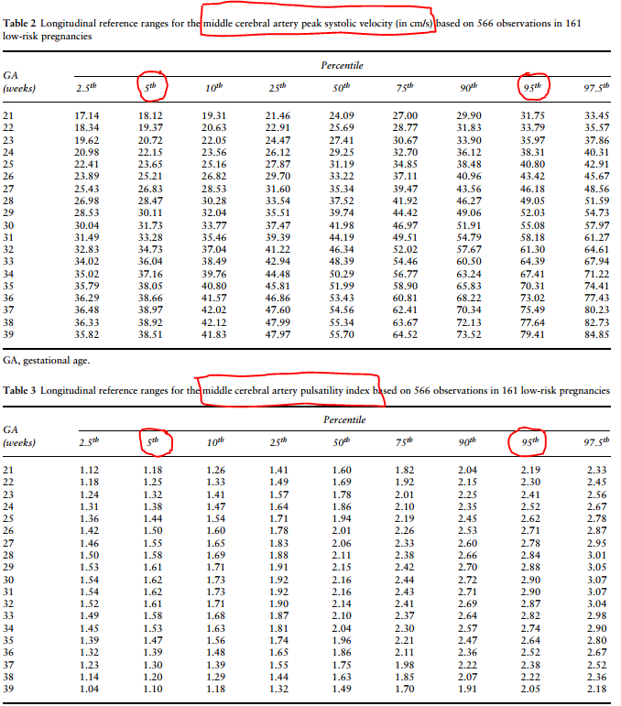

Slide 148
Normal MCA Doppler
wall filter: presumed low
Angle: OK
Gate: OK
Scale: OK
Tracing: OK
Waveform: Ok
Diastolic: always present and positive
Check numbers: PI & PSV (for anemia and twins)

Slide 149
Labelled MCA doppler
Need to see colour doppler with sampled vessel as best as possible
Labelled MCA but posterior vessel insonated not MCA

Slide 150
MCA doppler
wall filter: presumed low
Angle: OK
Gate: OK
Scale: OK
Tracing: BAD
Sample again or manually trace waveform

Slide 151
MCA doppler
wall filter: change to low
Angle: OK
Gate: too peripheral and cannot see vessel
Scale: OK
Tracing: BAD
Waveform: BAD
Not acceptable: resample

Slide 152
MCA doppler
wall filter: need to set to low
Angle: OK
Gate: not enough of vessel seen
Scale: too large for tracing
Tracing: OK
Waveform: not usual waveform
Diastolic: not always present
Resample: change to low filter, show more vessel, watch gate

Slide 153
MCA doppler
wall filter: low
Angle: OK
Gate: OK
Scale: too small
Tracing: OK
Waveform: Ok
Diastolic: always present and positive
Check numbers: INACCURATE because cannot see peak of waveform because scale too small

Slide 154
Loss of end diastolic flow, real?
Wave form peak looks blunted
Fetal head quite superficial
Take off pressure with transducer probe
Better technique: improve angle to zero, wall filter to low

Slide 155
MCA tracing
wall filter: low
Angle: OK
Gate: not clearly seeing MCA
Scale: OK
Tracing: OK
Waveform: Ok
Diastolic: missing end diastolic flow
Redo tracing to see MCA vessel more clearly

Slide 156
Is MCA PI really < 5 %tile? Correct technique before patient leaves
2D image: not true axial image to see MCA
wall filter: change to low
Angle: Incorrect at 45 degrees
Gate: need to see more of MCA
Scale: OK
Tracing: OK
Waveform: Ok
Diastolic: always present and positive
Numbers are inaccurate: need to redo sample

Slide 157
MCA Doppler
wall filter: presumed low
Angle: OK
Gate: OK
Scale: OK
Tracing: OK
Waveform: Ok
Diastolic: reversed
ABnormal: patient goes to hospital

Slide 158
MCA Reversal of EDF: Ominous (even for normal size fetus)

Slide 159
Take Home Points
2D Optimization
Watch focus, gain and DR/contrast
Colour Doppler Optimization
Check wall filter
Small & superficial box size
PRF scale
Power Doppler Optimization
Don’t forget to use when cannot get colour
Spectral Doppler Optimization
Don’t forget to prove colour/power is real

Slide 160
